Slide 1
Docker Concepts
Foundation for Modern Apps
Andy Tauber, Staff TAM
Dave Mazur, Staff TAM
February, 2021

Slide 2
Introduction
Introduction to Micro-service Architecture
Containers
Docker
Additional Information
Lab

Slide 3

Presentation and Playbook
Go grab a copy of the presentation and playbook to follow along
The playbook contains steps and commands we will be using
https://github.com/davemazur/tambootcamp-docker
https://gitlab.eng.vmware.com/atauber/tam-modern-apps

Slide 4
Introduction to Micro-Service Architecture

Slide 5
What’s Wrong with Traditional Applications
A quick example
Everything is tied to a single codebase
When one change is made, the entire application has to change
Application
Web/App Server
Database
Operating System
Notes:
A quick example:
EMC NAS storage application
monolithic app running on a derivative of linux
Needed a (1) character change from a (4) to an (8) to increase concurrent backup streams
Impacted a major financial customer backups
Took 2.5y to get into production (show a big 2.5 year circle)
3 tier (web, app, db) traditional monolithic app - stack
around for 20+ years
6+ month dev cycle

Slide 6
Reasons to Switch to Micro-services
Micro-services is an architectural style in which applications are decomposed into loosely coupled services
Increased resilience
Improved scalability
The right tool for the right task
Faster time to market
Easier debugging and maintenance
Micro-service UI
Micro-service
Micro-service
Micro-service
Micro-service
Notes:
Increase resilience
minimal impact of a failure
services act as separate entities
Improved scalability
can scale up a single component to meet demand
The right tool for the right task
each service can use its own language, framework or ancillary services
Faster time to market
you do not need to rewrite your entire codebase to add or modify a feature
you make changes to a specific service
Easier debugging and maintenance
the ability to deliver error-free applications is greatly enhanced
smaller modules going through a continuous delivery and testing process

Slide 7
Containers

Slide 8
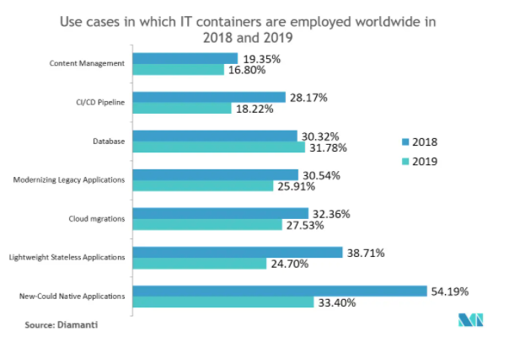
A Little Market Data...

Slide 9
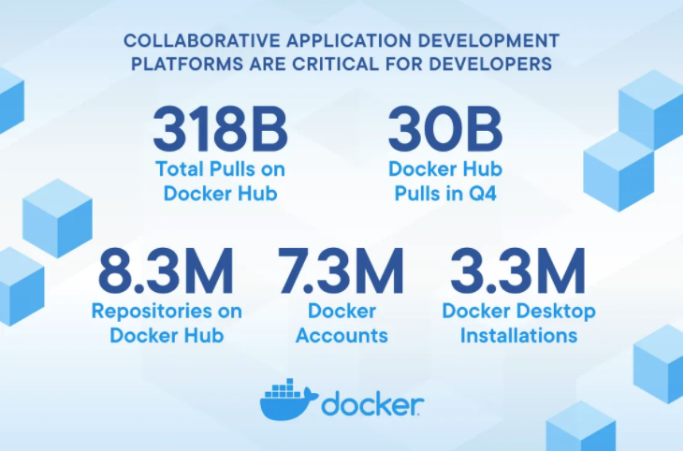
A Little Docker Data...

Slide 10
What’s a Container?
Standard unit of software that packages up code and all of its dependencies
Containers help create a reproducible environment
You specify the exact version of:
Application
Different libraries
Different environment variables
Different configuration settings
Allow you to run your application in isolation inside that environment
Allows applications to run quickly and reliably from one computing environment to another
Core component in a micro-service architecture
Container
App A
App B
App C
Bins/Libs
Bins/Libs
Bins/Libs
Container Runtime
Host OS
Infrastructure
Notes:
Simply put, a container is everything that you need to run an application packaged into its own little bundle of data.
A container pulls in the application code, its libraries and dependencies, any configuration files, and additional system tools it is reliant on.

Slide 11
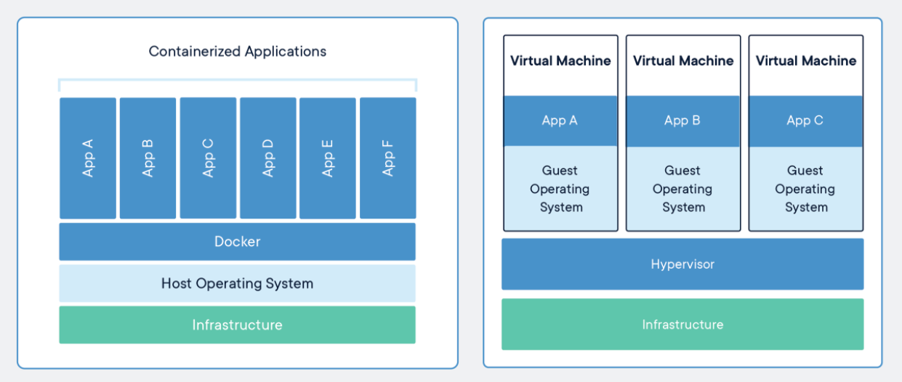
Containers vs VMs
Notes:
Both containers and VMs contain the application and any libraries needed to run it
Vm’s contain an operating system
Both technologies are complimentary, containers are deployed on virtual machines the majority of the time

Slide 12
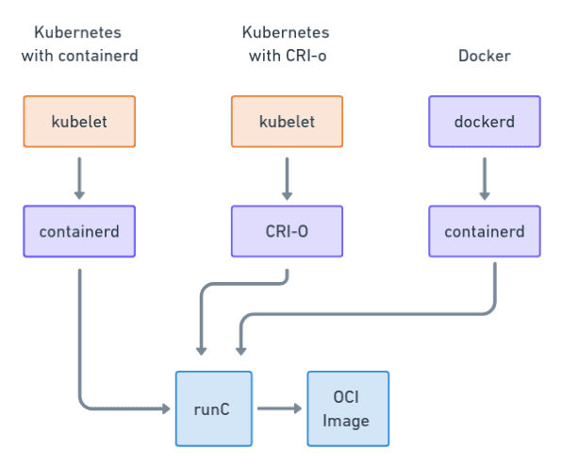
Container Runtime Formats
OCI is a runtime specification that describes how to unpack and run a container
runC is the OCI maintained implementation
OCI standard provides interoperability between container solutions
CRI
OCI Runtime
Notes:
OCI – open container runtime
- Players in the space – runC, crun(RedHat)
CRI – container runtime interface (into the OCI runtime)
- Two main CRI players – CRI-O and containerd

Slide 13
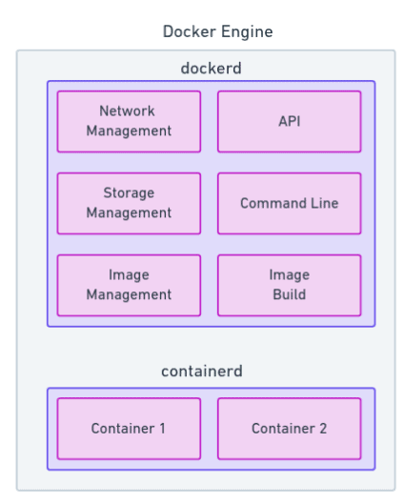
Docker Engine
Docker is divided into two services
Containerd
- managing containers
Dockerd
- everything else

Slide 14
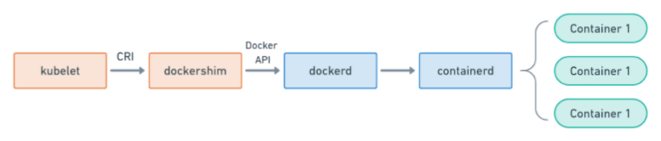
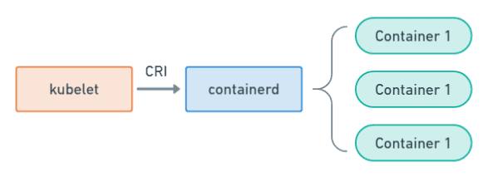
Dockershim Deprecation
Kubernetes is shifting away from Docker
Kubernetes with Docker Shim (currently being deprecated
Kubernetes with containerd

Slide 15
Docker

Slide 16
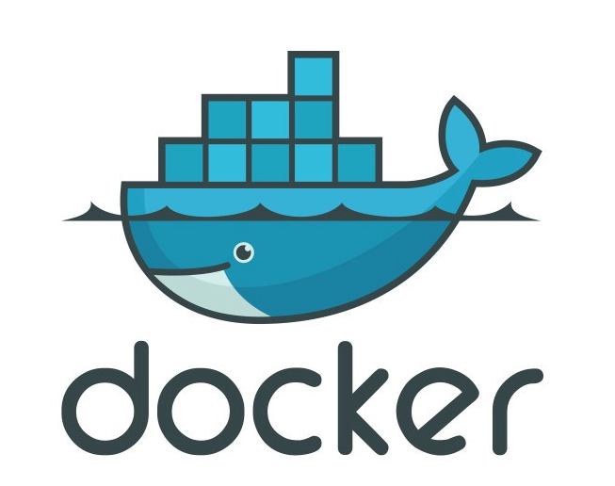
Docker Defined
Docker is a tool designed to make it easier to create, deploy and run applications using containers.

Slide 17
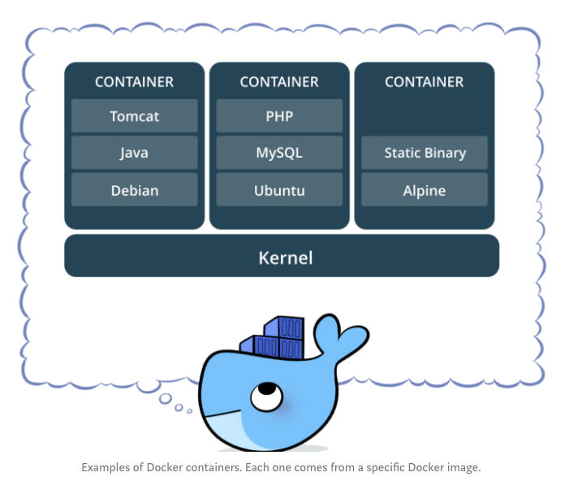
Container Examples

Slide 18
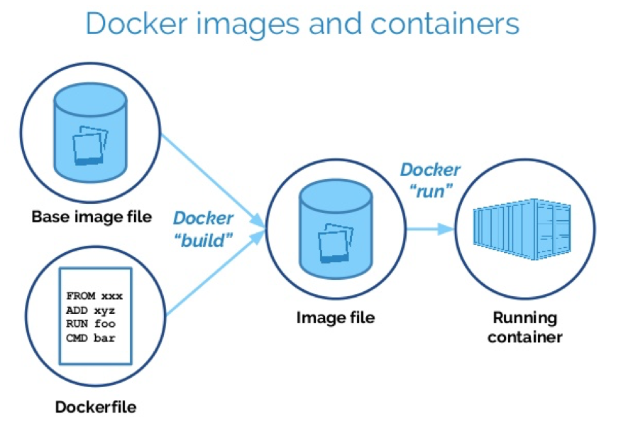
Basic Container Architecture
Images
Storage
Network
Plugins
Notes:
A Docker image is read-only file that contains the source code, libraries, dependencies, tools, and other files needed for an application to run.
A Docker container is a virtualized run-time environment where users can isolate applications from the underlying system.
An image is used as the template, which a developer can copy and run as an application in an isolated environment - a container

Slide 19
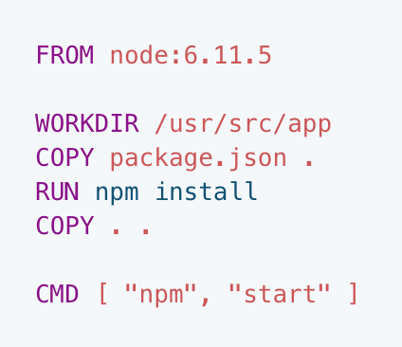
Dockerfile
Text document
Contains all commands to build an image
The docker build command reads the Dockerfile and uses that to build an image
Notes:
Start FROM the pre-existing node:6.11.5 image. This is an official image, built by the node.js vendors and validated by Docker to be a high-quality image containing the node 6.11.5 interpreter and basic dependencies.
Use WORKDIR to specify that all subsequent actions should be taken from the directory /usr/src/app in your image filesystem (never the host’s filesystem).
COPY the file package.json from your host to the present location (.) in your image (so in this case, to /usr/src/app/package.json)
RUN the command npm install inside your image filesystem (which will read package.json to determine your app’s node dependencies, and install them)
COPY in the rest of your app’s source code from your host to your image filesystem.

Slide 20
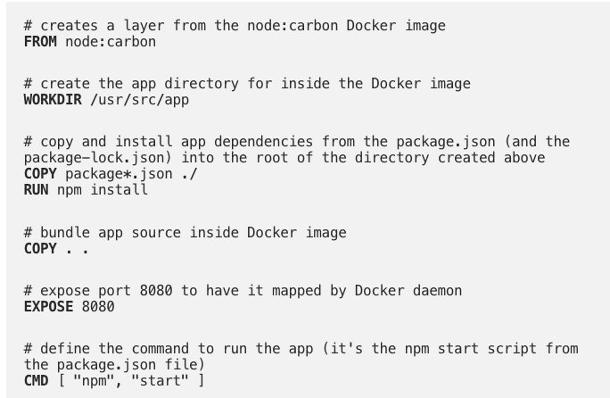
Dockerfile Example

Slide 21


Docker Flow
Users
Container
Container
Docker Registry
App A
App B
Push Image
Bins/Libs
Bins/Libs
3
4
1
Docker Client
Start instance of image
Place screenshot here
API
Docker Runtime (dockerd)
2
Host OS
Version Control
Build Image
Infrastructure
Docker File for A
Docker File for B
Notes:
The Docker daemon (dockerd) listens for Docker API requests and manages
The Docker client (docker) is the primary way that many Docker users interact with DockerDocker objects such as images, containers, networks, and volumes.
The docker command line uses the Docker API.

Slide 22
Basic Docker Commands
docker build {creates an image}
docker images {list images (and their repository)}
docker run (-d daemon mode)
docker ps
docker stop/start {stop allows you to later restart the container}
docker exec {run a cmd in a running container}
docker push/pull
docker rm {remove the container completely}

Slide 23
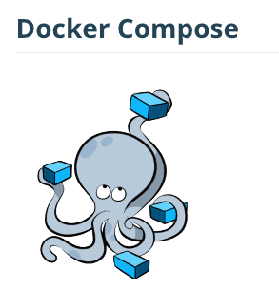
Docker Compose
Tool for defining and running multi-container docker applications
Manages the application life cycle
Start, stop, rebuild services
View the status of running services
Stream the log output of running services
Run a one off command
Build several images at once, start several containers

Slide 24
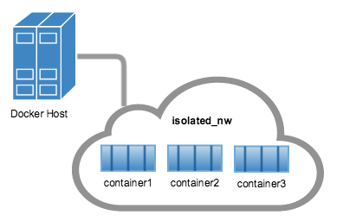
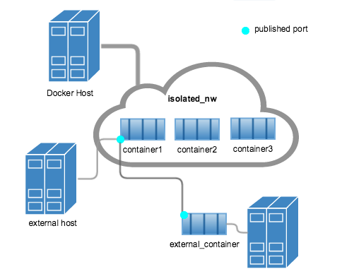
Docker Networks
Bridge
default, used in standalone container
Host
swarm, remove network isolation between container and docker host
Overlay
Overlay networks connect multiple Docker daemons together and enable swarm services to communicate with each other
Macvlan
allow you to assign a MAC address to a container, making it appear as a physical device on your network
None
disable all networking

Slide 25
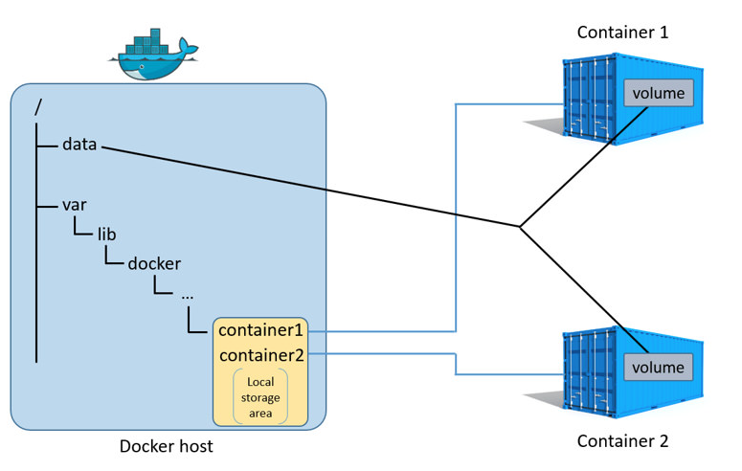
Docker Storage
Means of persistent storage
Otherwise everything we did goes away
Typical persistent data
Log files, databases, JSON files
Basic commands
docker volume create
docker volume ls
docker volume prune
docker volume rm
docker inspect [name of volume]
attach a volume to a container
docker run -d -p 8000:3000 --name my-container --volume my-volume:/xxx/yyy

Slide 26
Docker Plugins
Out-of-process extensions that add capabilities to the docker engine
Run on the same or different host as the docker engine
Registers itself with Docker
Can run inside or outside containers (running outside is recommended)
Docker Plugin API
https://docs.docker.com/engine/extend/plugin_api/
Examples
IPAM
Network drivers
Authorization
Docker Engine
Container
App A
IPAM Plugin
Bins/Libs
IPAM

Slide 27
Docker Swarm
Orchestration
Dockers version of cluster management and orchestration
Native to Docker
Provides tools for scaling, networking, securing and maintaining your apps
Notes:
Dockers version of orchestration
Provides tools for scaling, networking, securing and maintaining your apps

Slide 28
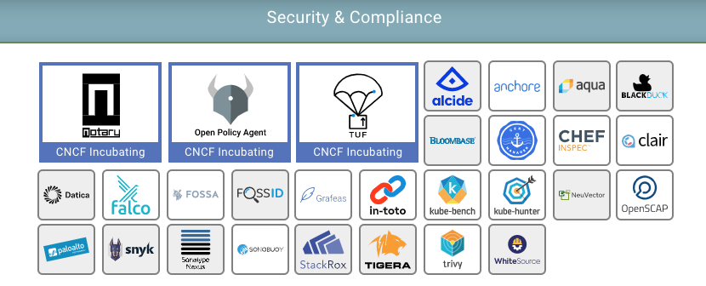
Security Concerns
Unsecured communication and unrestricted network traffic
Unrestricted access of process and files
Kernel level threats
Inconsistent update and patching of docker containers
Unverified docker images

Slide 29
Product Example
Using Containers/Micro-Services

Slide 30
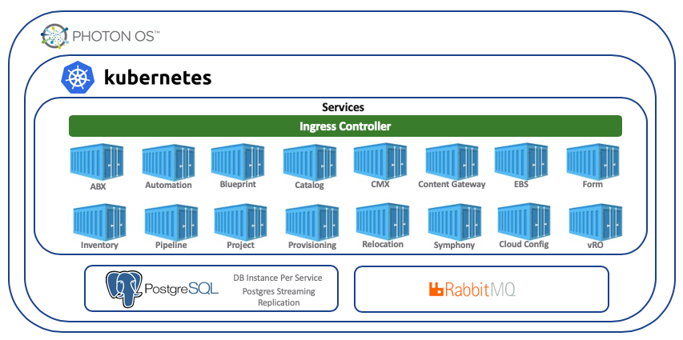
vRealize Automation 8.0
Notes:
(40) services....how do you manage that???

Slide 31
Additional Information

Slide 32
Information and Tutorials
Docker step-by-step tutorial
https://docs.docker.com/get-started/
https://linuxacademy.com/blog/docker/6-years-of-docker-hands-on-docker-training/
Cloud Native Computing Foundation
https://landscape.cncf.io/
Cloud Native Applications (CNABU)
https://confluence.eng.vmware.com/pages/viewpage.action?pageId=115976924

Slide 33
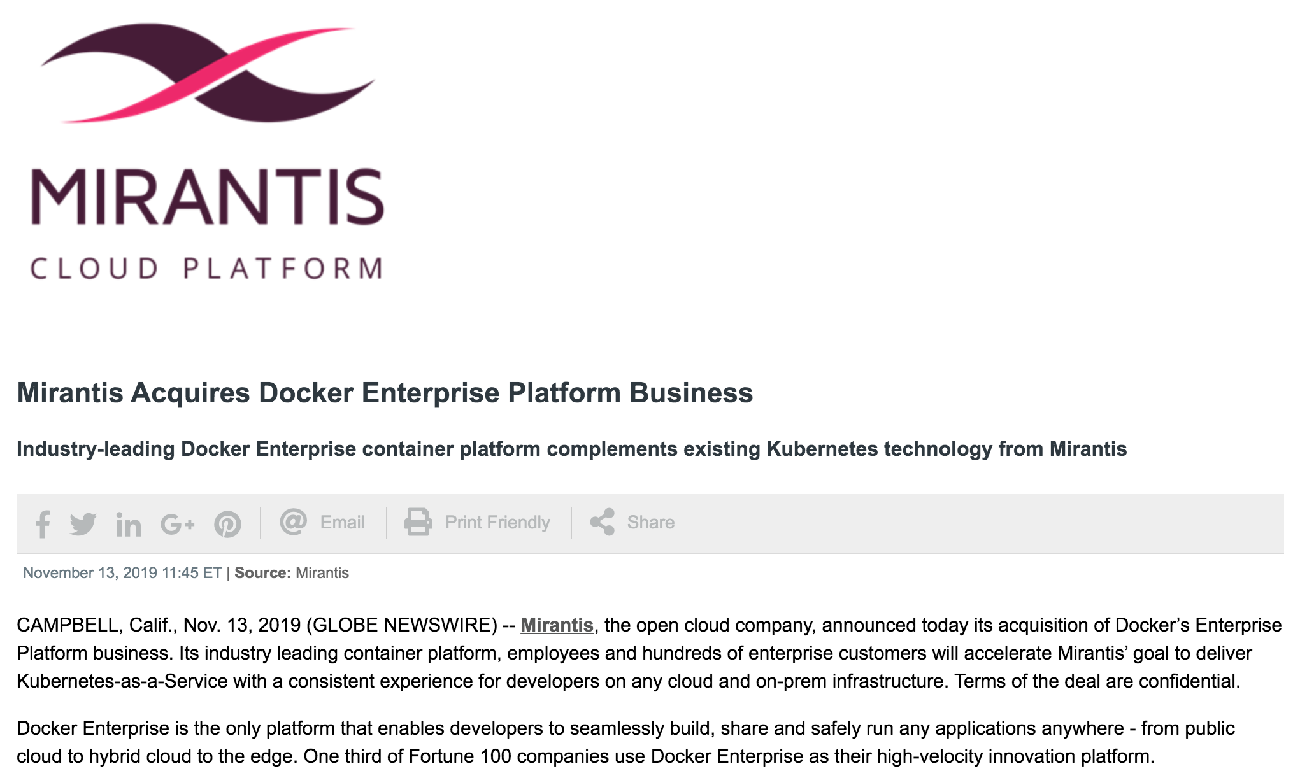
Mirantis Acquires Docker

